Slide 1



CUSTOMIZED AI KITCHEN FOR INDIA

Slide 2

TABLE OF CONTENTS:
1
Customized AI Kitchen
5
Dishwasher
2
Features Offered
Robotic Arm
6
3
Process Flow
7
Technologies Used
7
4
Smart Oven
8
Conclusion

Slide 3

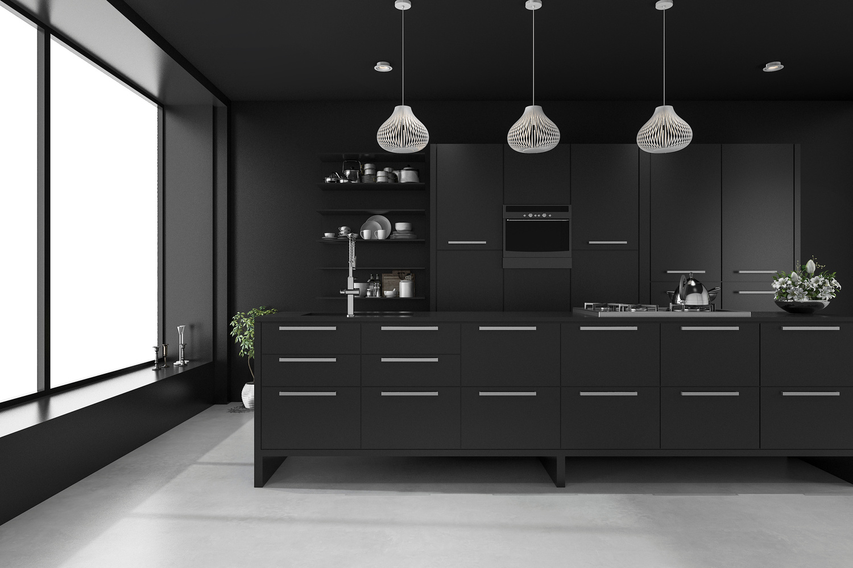
WHAT IS SMART KITCHEN?
Smart Kitchens involve smart devices that automate cooking tasks.
These kitchens have feature devices like smart ovens and dishwashers, which one can remotely control.
Compared to old and traditional kitchens, AI-enabled kitchens have an immense functional advantage.

Slide 4
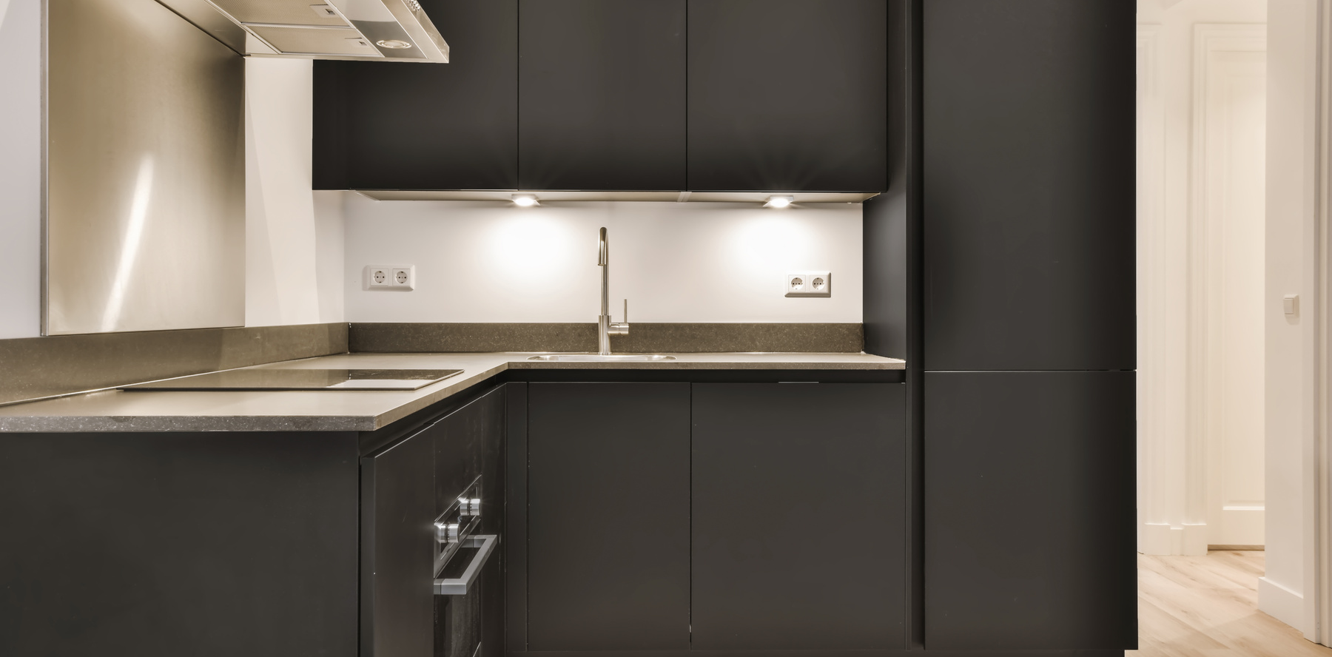
FEATURES OFFERED
VOICE COMMANDS
Intuitive voice control allows users to seamlessly navigate the kitchen, set timers, and adjust settings with ease.
RECIPE RECOMMENDATIONS
The AI-powered system suggests personalized recipes based on dietary preferences, ingredients on hand, and cooking expertise.
AUTOMATED COOKING
PREDICTIVE MAINTENANCE
Advanced sensors and algorithms optimize temperature, timing, and cooking methods to deliver perfectly cooked meals.
The system monitors kitchen appliances and proactively alerts users to maintenance needs, ensuring optimal performance.

Slide 5
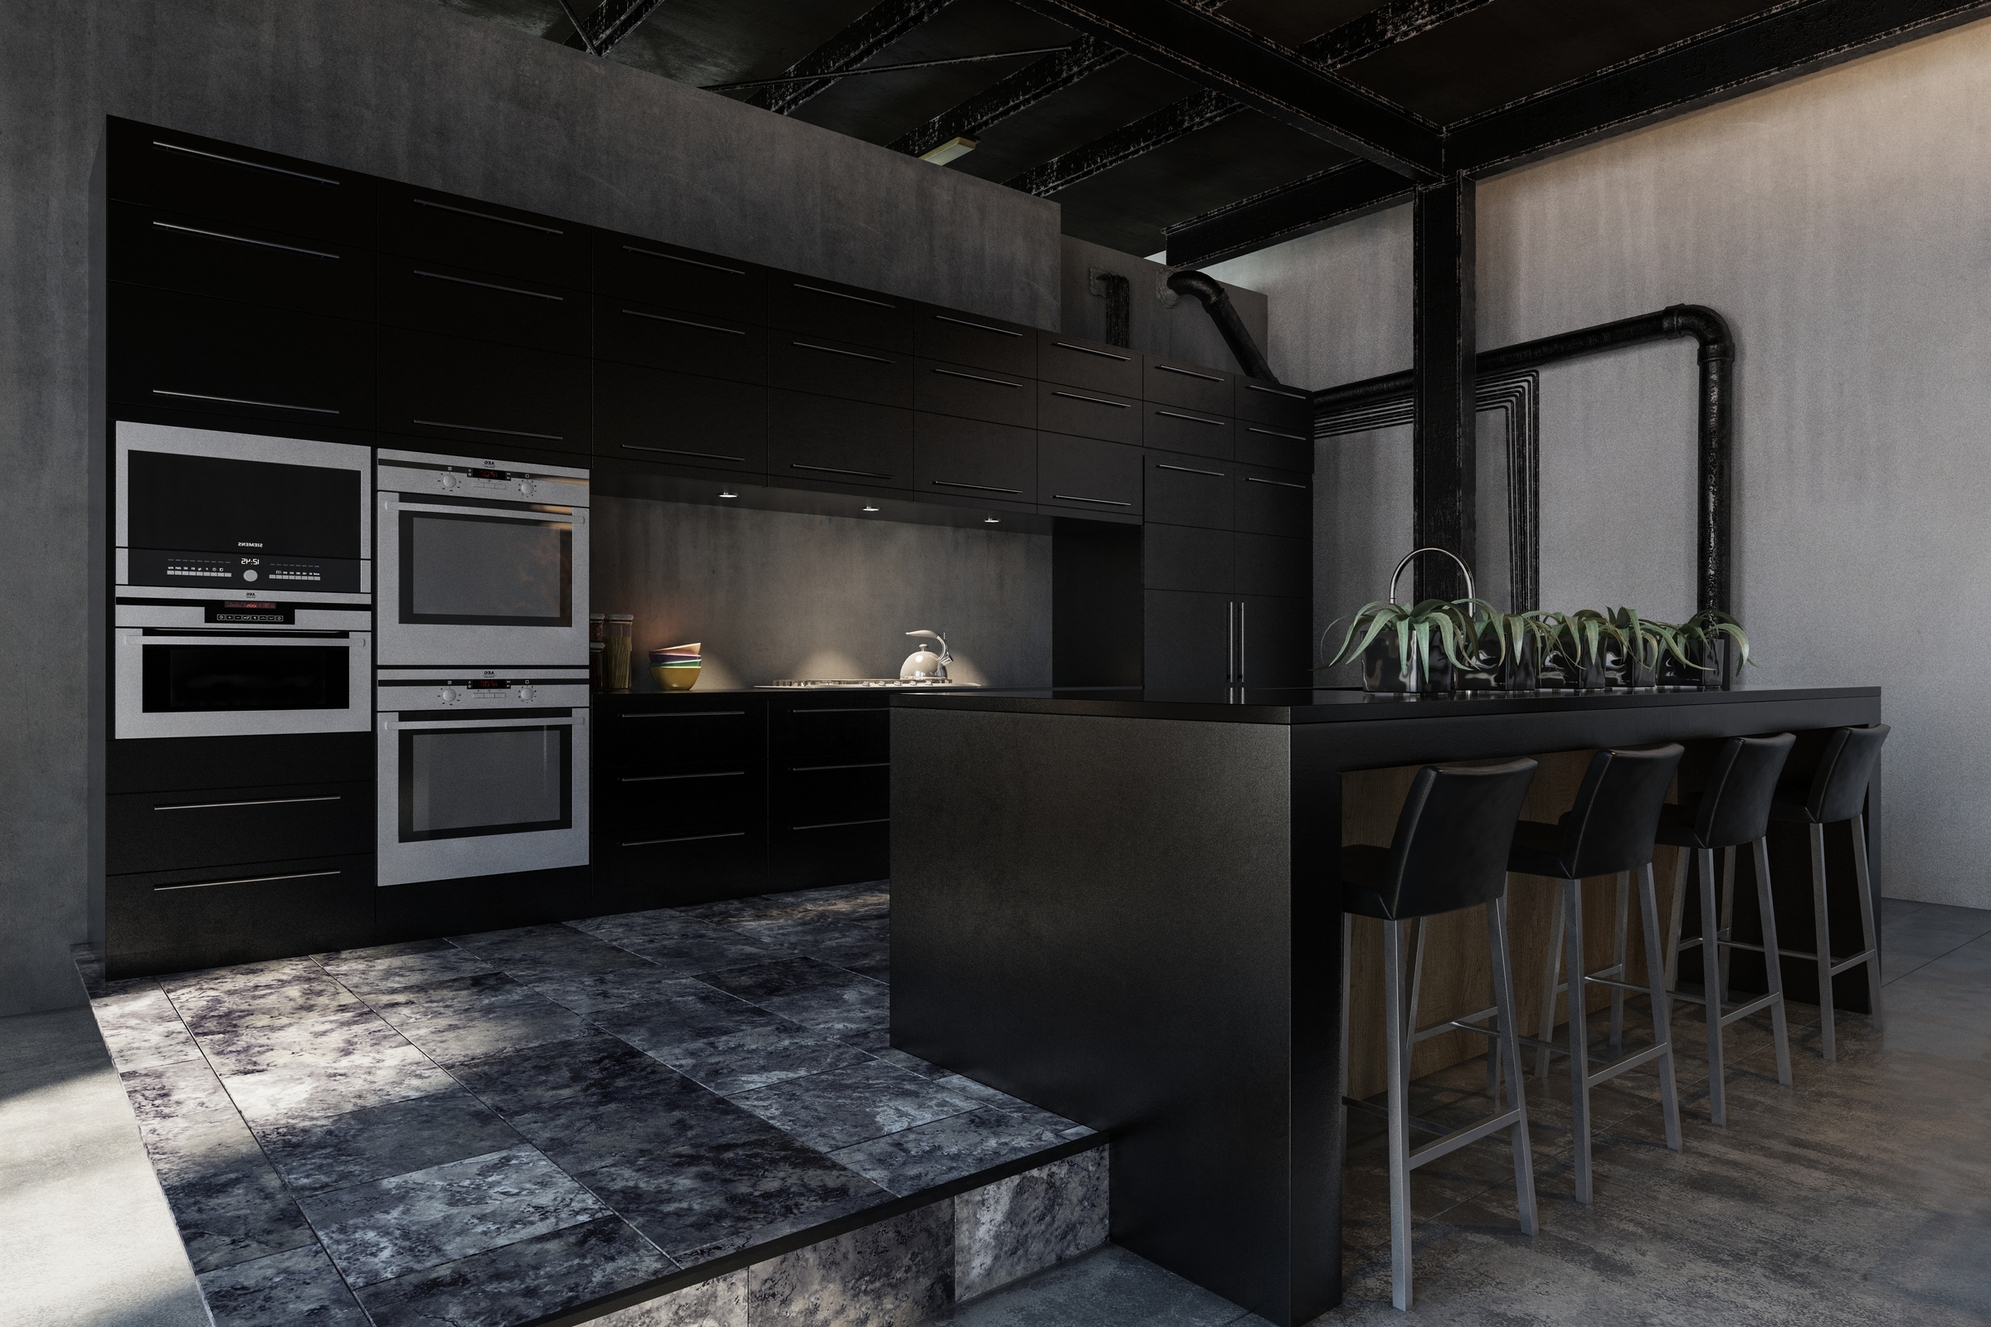
PROCESS FLOW
1.INSTALLATION
The AI kitchen system is seamlessly integrated into the home, with minimal disruption to the existing kitchen layout.
2.CUSTOMIZATION
Users can personalize their preferences, dietary requirements, and cooking habits, allowing the AI to tailor the experience.
3.COOKING ASSISTANCE
The AI kitchen provides step-by-step guidance, real-time monitoring, and adjustments to ensure successful meal preparation.

Slide 6
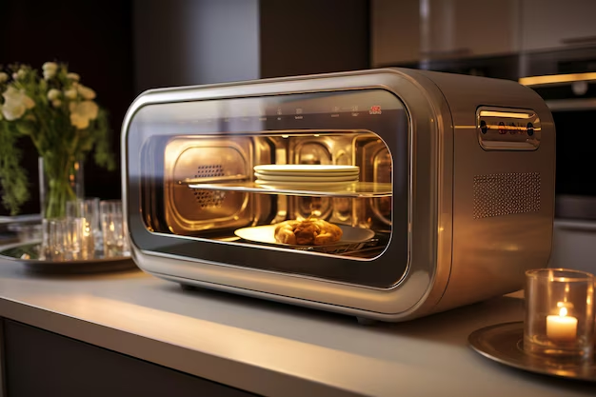
SMART OVEN
An oven provides a temperature higher than that of atmosphere.
The temperature range covered by ovens is between 50-250 degree Celsius.
These are used for rapid evaporation of materials, rapid drying and for sterilization of articles that can be sterilized by dry heat.
Dry heat sterilization technique requires longer exposure time(1.5 to 3 hours) and higher temperature than moist heat sterilization.

Slide 7
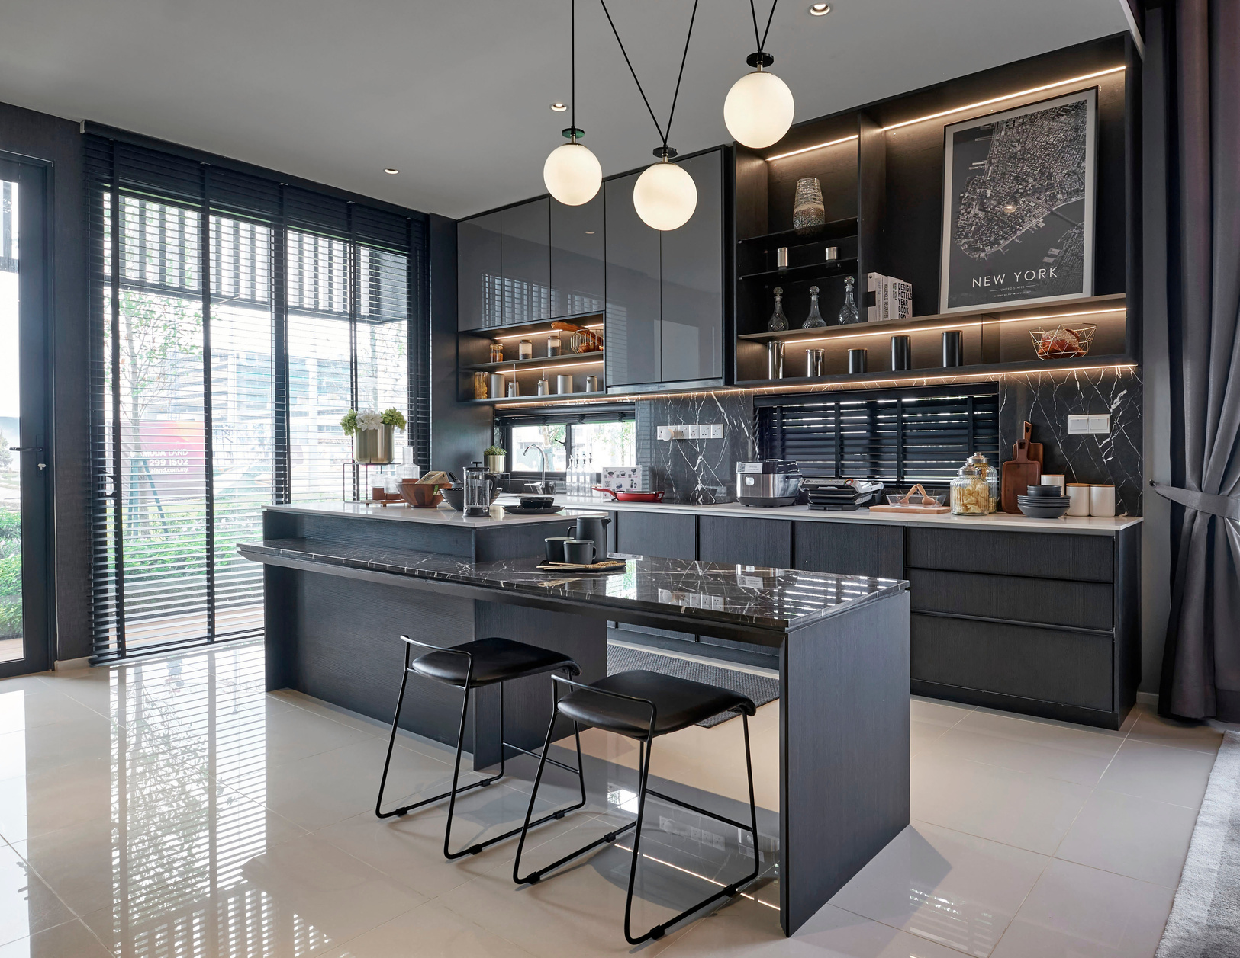
WORKING OF SMART OVEN
The most common time-temperature relationships for sterilization with hot air sterilizers.
The contents must not be removed from the oven immediately as a slow cooling period is necessary-ideally when the temperature has reduced down to 50 degree celsius, but no less.
Used for glassware forceps, swabs, water impermeable oils, waxes and powders.
Before placing in hot air oven dry glassware completely, plug test tube with cotton wool, wrap glassware in Kraft papers.
Don’t over load the oven.
Allow free circulation of air between the material.

Slide 8
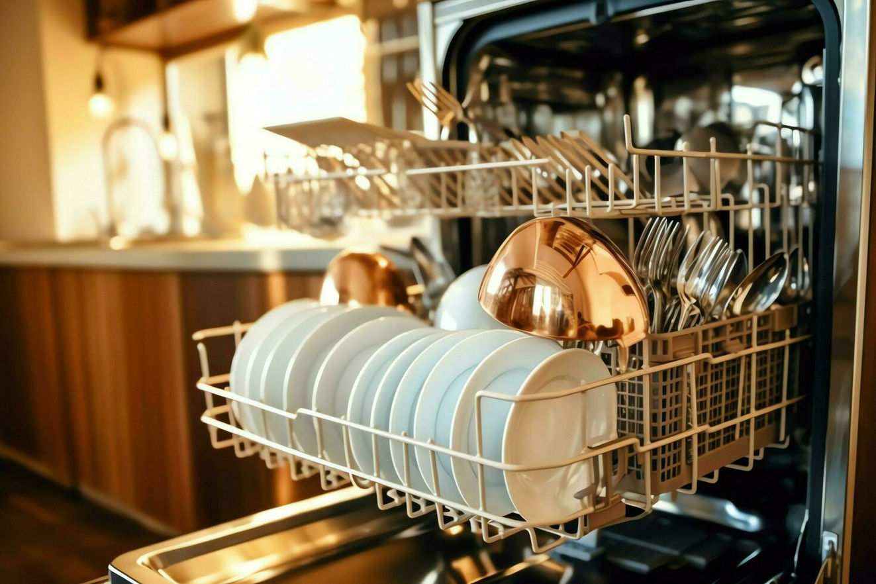
DISHWASHER
A dishwasher is a household appliance that automates the process of cleaning dishes, cookware, and utensils. Here's a step-by-step outline of the typical process flow of a dishwasher
1. Loading
Arrange Dishes: Place dirty dishes, cookware, and utensils in the designated racks inside the dishwasher.
Add Detergent: Add the appropriate amount of dishwasher detergent to the detergent dispenser.
2. Pre-Wash
Initial Rinse: Some dishwashers perform an initial rinse to remove loose food particles from the dishes.

Slide 9
3. Draining
Drain Cycle: After the wash cycle, the dirty water is drained out of the dishwasher through a drain hose.
4. Rinsing
Rinse Water Fill: Fresh water is introduced into the dishwasher for rinsing the dishes.
5. Draining (Rinse Cycle)
Drain Rinse Water: The rinse water is drained out of the dishwasher.
6. Drying
Drying Process: The drying method depends on the dishwasher model and settings.
7. Unloading
Cool Down: Allow the dishes to cool down before opening the dishwasher to avoid burns from hot steam.

Slide 10
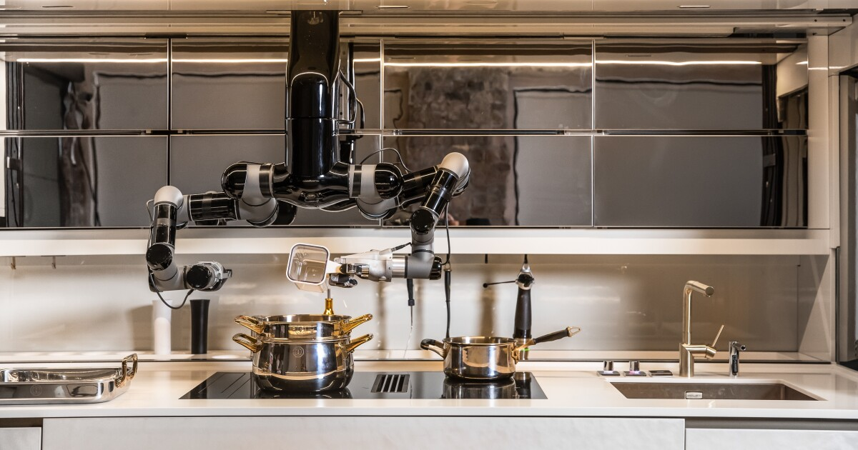
ROBOTIC ARMS

Slide 11
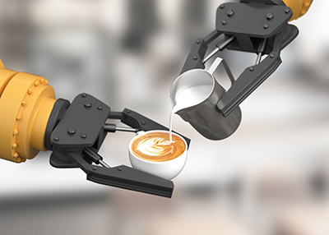
ROBOTIC ARMS
Robotic arms are mechanical devices that are designed to mimic the function and movement of a human arm. They are commonly used in a variety of industries, including manufacturing, healthcare, and research.
Joints and Links: Robotic arms consist of segments (links) connected by joints, allowing them to move in different directions and positions.
Degrees of Freedom (DOF): This refers to the number of independent movements a robotic arm can make. The more degrees of freedom, the more versatile the arm.
End Effector: The tool or device attached to the end of the arm, such as a gripper, welding torch, or paint sprayer, depending on the application.

Slide 12





TECHNOLOGIES USED
Cloud Computing
IoT Integration
Machine Learning
Natural Language Processing

Slide 13
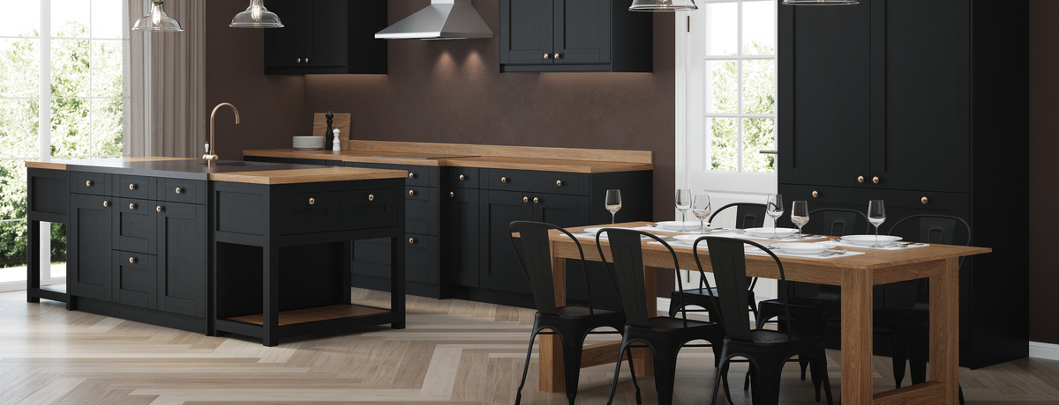


CONCLUSION
A customized AI kitchen holds promise in revolutionizing culinary experiences by integrating advanced technology with personalized user preferences.
Key considerations include cultural adaptability, technological integration, user-friendly interfaces, ingredient recognition, energy efficiency, health aspects, and robust data security.
By addressing these factors, AI kitchens can optimize cooking processes, enhance nutritional choices, and cater to diverse lifestyles, ultimately reshaping how we approach food preparation and consumption.

Slide 14
THANK YOU
By-
Mitali.C.Rangani
4th Sem, AIML
GM Institute Of Technology,
Davangere

